Slide 1
Advanced Technology Vehicles
What, When, How Many??
Dave Baxter
Toyota Technical Center, USA, Inc.
Notes:
Good afternoon, ladies and gentlemen.
My name is Dave Baxter. I am the Vice President for Regulatory Affairs at Toyota’s Technical Center in Ann Arbor, Michigan.
I’m pleased to have this opportunity today to review with you Toyota’s vision of the future for Advanced Technology vehicles and the role hybrid vehicles play in that future.

Slide 2



TOYOTA ECO-Project
The Ultimate ECO Car
FCHV
THS
EV
Diesel DI
Series Hybrid
CNG
D-4
Lean Burn
VVT-i
Alternative
Fuel
Diesel
Engine
Gasoline
Engine
Hybrid
Vehicle
Electric
Vehicle
Notes:
At Toyota, we firmly believe that there is more than one answer to the issue of personal transport systems for the 21st century. We are working in a wide range of areas as shown in this chart. I should also note that our competitors all have similar plans, as ours is an intensely competitive business.
Toyota believes that among these many technologies the hybrid vehicle has perhaps the greatest promise. Today, I will focus on the hybrid path.
But first some background.

Slide 3
What is an Eco Vehicle?
Low Criteria Emissions
Low CO₂ Emissions
Highly Recyclable
Low Manufacturing Emissions
Notes:
What is meant by the term ECO? It turns out it means different things to different groups:
* For many in the US, it is low smog forming emissions: HC, CO, NOx and particulates.
* For many outside the US, it is low CO2 or Greenhouse Gas (GHG) emissions.
* Especially in Europe, it means a highly recyclable vehicle.
* If you live near an auto plant, it may mean low manufacturing emissions for solids, water and air contaminants.
At Toyota, we are attempting to address all these concerns.

Slide 4
Necessary Conditions
for Market Acceptability
Acceptability Issues
Convenience
Infrastructure
Price
Notes:
Now, I’d like you to imagine that we have managed to develop an environmentally-friendly, revolutionary vehicle.
It would, of course, be exhibited at motor shows and get a lot of attention from the press.
It would also probably enjoy recognition at national and international technical gatherings. Further it would be the focus of attention from various researchers and engineers, including our competitors.
But, in reality, for a car to have a genuine impact on the environment, it needs to be widely acceptable to the consumer and sold in volume.
For this to happen, it needs to be user-friendly, use a fuel which is readily available to the public and for which the appropriate infrastructure exists, and it must be possible for the manufacturer sell it at an affordable price.

Slide 5
What Does the Market Want?
A significant and growing percentage of customers indicate a willingness to buy an environmentally friendly vehicle,
if and only if, all other attributes are equal
Notes:
In response to internal Toyota marketing trends studies, growing numbers of customers have indicated that they would buy an environmentally friendly vehicle. That’s the good news.
* However, they are not interested in any compromise to the excellent attributes of their current vehicles. I should also point out that there is significant resistance to premium pricing.
This in large measure explains the niche market appeal of battery electric and alternative fuel vehicles.

Slide 6
Toyota Hybrid Objectives
Significant Increase in Fuel Economy over Conventional Gasoline-Powered Vehicles
Significant Reductions in Exhaust Emissions
Smooth, Responsive Power Train
No New Infrastructure
Competitive Price for Clean Vehicle Penetration
Notes:
Five basic objectives drove the hybrid development process.
* First was significantly improved fuel economy.
* We also targeted a major reduction in exhaust emissions.
* Customer should not perceive any difference in responsiveness or driveability.
* No need for new infrastructure.
* Cost must be reasonable to assure market acceptance. Clean technologies only impact air quality when sold in volume.

Slide 7
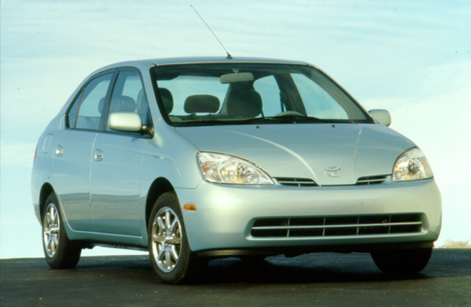
Prius - Gasoline/Electric Hybrid
Notes:
The Toyota hybrid vehicle - Prius - combines the practical advantages of a somewhat “unconventional” gasoline engine and an integrated electric drive system. This product was developed to achieve both great emissions performance and great fuel efficiency. While satisfying customer demands for other attributes.

Slide 8
Vehicle Specifications
Length
(in)
168.3
Width
(in)
66.7
Height
(in)
57.6
Wheelbase
(in)
100.4
Curb weight
(lb)
2,728
CD
0.29
$19,995 + shipping
Notes:
These are the specifications for the 2001 Prius, available at a Toyota dealer near you. It is an EPA “compact” class sedan with a longer than typical wheel base and short overhangs. It has more cabin space than Corolla, but less than Camry. It is a traditional construction, steel, vehicle with good aero for its taller than typical stance.

Slide 9
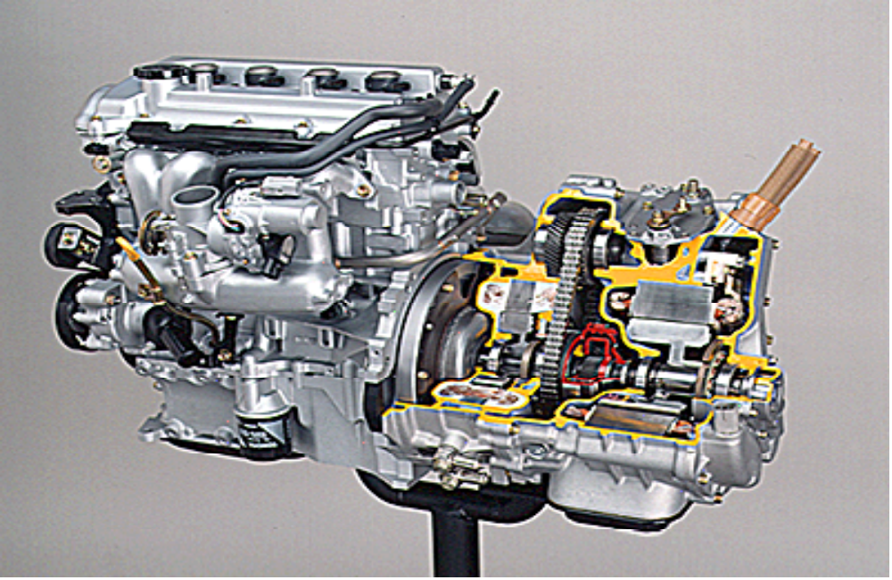
Engine and THS Transmission
Notes:
This photo is of a cut-away model of the system.
We have replaced the automatic transmission with a single planetary gear set, a motor and a separate generator. We are also able to remove the starter and alternator. The generator is motored to start the engine and via the inverter charges both the main pack and the service battery.
Both of the electric machines are 3-phase permanent magnet devices and the inverter uses IGBT technology. The electric machines and the power electronics will be similar for all electric drive vehicles and represent two of the three major differences from today’s vehicles. The third difference is the batteries.

Slide 10
THS Gear Train
Planetary Gear
Generator
Damper
Engine
Motor
Chain
Counter Gear
Final Gear
Axle Shaft
Notes:
This graphic shows all the elements in the THS gear train. The engine is connected to the carrier of the planetary gear set. The generator is connected to the sun gear. And the motor and final drive are connected to the ring gear. As you can see there are no friction elements in the transmission, no clutches or bands. This package results in a mechanically simple, but elegant solution to the hybrid drive integration problem.

Slide 11

Hybrid Power Management
+
Energy Supply to
Make Up for Shortage
Battery
Recovery of
Braking Energy
Power
Recharge
During Cruise
Time
Maximum Efficiency Engine Operation
Power Required to Drive Vehicle
-
Engine Output Power
Notes:
This is a concept illustration of the power management system of the THS.
* The red line shows the required power to drive the vehicle,
* and the blue line shows the engine output power.
* Initial move-off power is supplied by the electric motor as it produces 100 percent of its peak torque from zero speed. When power requirements increase, the generator starts the engine and the electric motor is used as needed to supplement acceleration.
* Above a threshold for maximum efficiency (10 kW), the engine can be used for both drive power and battery charging.
* When the power demand falls below 7 kW, such as descending a slight grade or moving very slowly, fuel and spark are cut off and the engine is stopped.
* In addition, vehicle kinetic energy can be converted to electric energy during deceleration and returned to the battery.

Slide 12
Prius ICE Operation
ICE Engine
ON
OFF
LA#4 (Cold start)
mile
2001MY Prius
8
cumulative range
4
mph
60
0
EV 3.2 miles out of 7.5 miles (43%)
40
speed
20
0
Notes:
One question I am often asked is what is the all-electric range of Prius. The answer is zero. By design intent, the motor and battery are not sized to allow all-electric range as defined in the California regulation.
This graphic, however shows the percent electric operation over the cold start portion of the FTP. On this test Prius moves under electric power, engine off, for 43% of the total 7.5 mile cycle.

Slide 13
Fuel Economy
US Combined
(CAFE)
58 mpg
31 mpg
Prius
45 mpg
US Highway
(Label)
31 mpg
Average
Compact
US City
(Label)
52 mpg
23 mpg
0
20
30
40
50
60
mpg
Notes:
Here are the fuel economy values for Prius. For comparison, I have included the sales-weighted average values for the EPA “Compact” class. I should note that these average values are only available through 1999, but have not changed significantly in recent years. The label values are the adjusted public numbers, while the CAFÉ number is the as tested or raw value.
Compared to the average EPA compact vehicle, Prius shows a city fuel economy increase of 126%.
In US highway mode, the increase is 45%.
On a CAFE basis the improvement compared to the average compact is 87%.

Slide 14
Improvements in Fuel Efficiency
increase
in efficiency
engine turn
off
braking energy regeneration
increase
in efficiency
U.S. City Mode
U.S. HWY Mode
Notes:
With this slide let me explain the sources of fuel efficiency improvements for the Prius. The diagram shows the breakdown of fuel economy improvements in US city driving and highway modes relative to a Toyota Corolla.
In the US city mode, the fuel efficiency improvement is comprised of three factors: increases in powertrain efficiency through engine modification and transmission improvements, engine shut-down during light loads and braking energy recapture or regeneration.
Since there is limited regenerative braking or engine shut-down opportunity on the highway, relative fuel economy improvement is greater in city operation than on the highway.

Slide 15
Emissions
California SULEV:
  0.01 g/mi NMOG
  0.02 g/mi NOx
  (@ 120,000 miles)
Enhanced Evap
OBD II
Notes:
This slide addresses Prius emission performance. Just for calibration the current ULEV standards allows 0.055 g/mi NMOG and 0.3 g/mi NOx at 100,000 miles. This makes SULEV much more than 82% and 93% more stringent for NMOG and NOx given the longer durability requirement.
These lower levels are possible by hybridization and more aggressive exhaust after-treatment including an HC adsorber.

Slide 16
GHG Emission
Relative GHG - Full Fuel Cycle
(Compared with Conventional Gasoline Engine)
0
0.5
1.0
Gasoline Engine
Prius
EV
CA
US Average
FCEV
Methanol Reformer
H2
Gasoline Reformer
Driving Condition: US City/Highway Combined
Notes:
When we look at the emission benefits of hybrids, our focus is on both criteria emissions (HC, CO and NOx) and Green House Gases (GHG). This figure shows the GHG emission impact including fuel cycle emissions for several technologies. By greenhouse gases I am referring to CO2, methane and nitrous oxide, appropriately weighted. These data are from Argonne Labs GREET model.
Where power plants are clean like California, EVs show low GHG emissions; however, using US average power generation, GHG emissions double.
A direct hydrogen fuel cell shows only 25% of gasoline GHG emissions. However, a gasoline reformer is about 50% and a methanol reformer is between them.

Slide 17
HEV Product Announcements
Toyota Prius - On sale 12/97 (Japan), 7/00 (US)
Honda Insight - On Sale 12/99
Nissan Tino - On sale 2000 (Japan) limited
Toyota Estima - 2001 (Japan)
Honda Civic - 2001 (Japan)
Ford Escape - 2003 MY
Ford Explorer ISG - 2004 MY
GM ParadiGM - 2004 MY
Dodge Durango - 2003/4
Notes:
This slide summarizes product announcements I’m aware of, but given the pace of announcements, it is likely out of date. I should note that not all these vehicles have comparable levels of hybridization. In other words, there is a wide variation in the absolute and relative size of the electric portion of the drivetrain. These variations affect both cost and the impact of hybridization on vehicle performance, emissions and fuel economy.

Slide 18
HEV Volumes
Prius - Total: ~60,000 US: 9,000 (1,000/mo)
Insight - Total: ~10,000 US: 4,500 (<500/mo)
Tino - Total: 20
Notes:
These are approximate sales volumes for the three production vehicles. I am not aware of any forecasts for volume targets of other announced products.

Slide 19
Issues for HEVs:
Cost Reductions
  Still early on the cost reduction curve
Mitigation of Price Premium
  Current Price Premium is ~$3,500
  Unique attributes offset some premium, but
  Incentives would increase volume
Mass and Volume Reductions
  Mass burden 50-150 kg
  Volume increase due to battery and electronics
Notes:
As you will note, we are a long way from done with development of this technology and many factors will drive us forward.

Slide 20
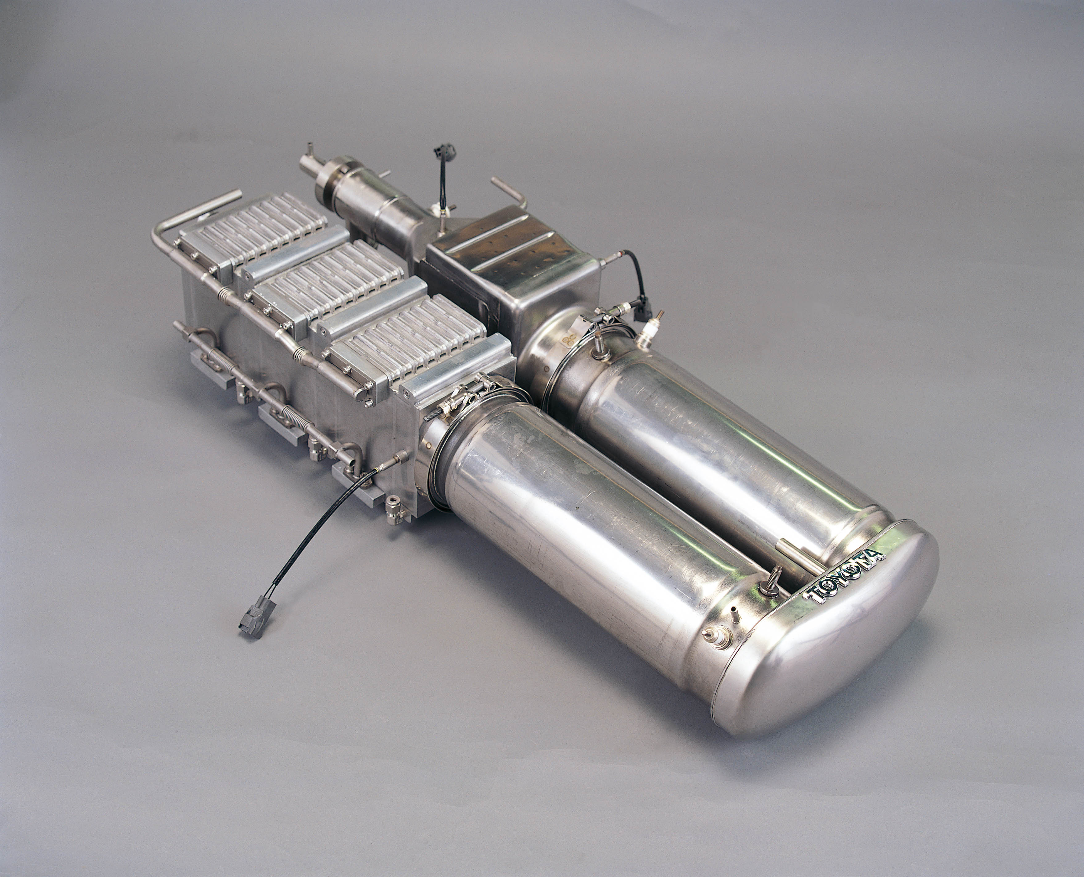

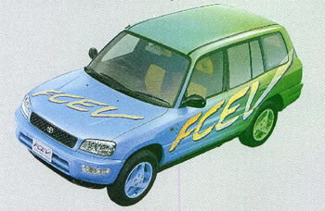
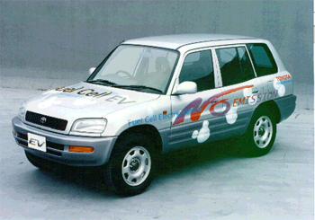
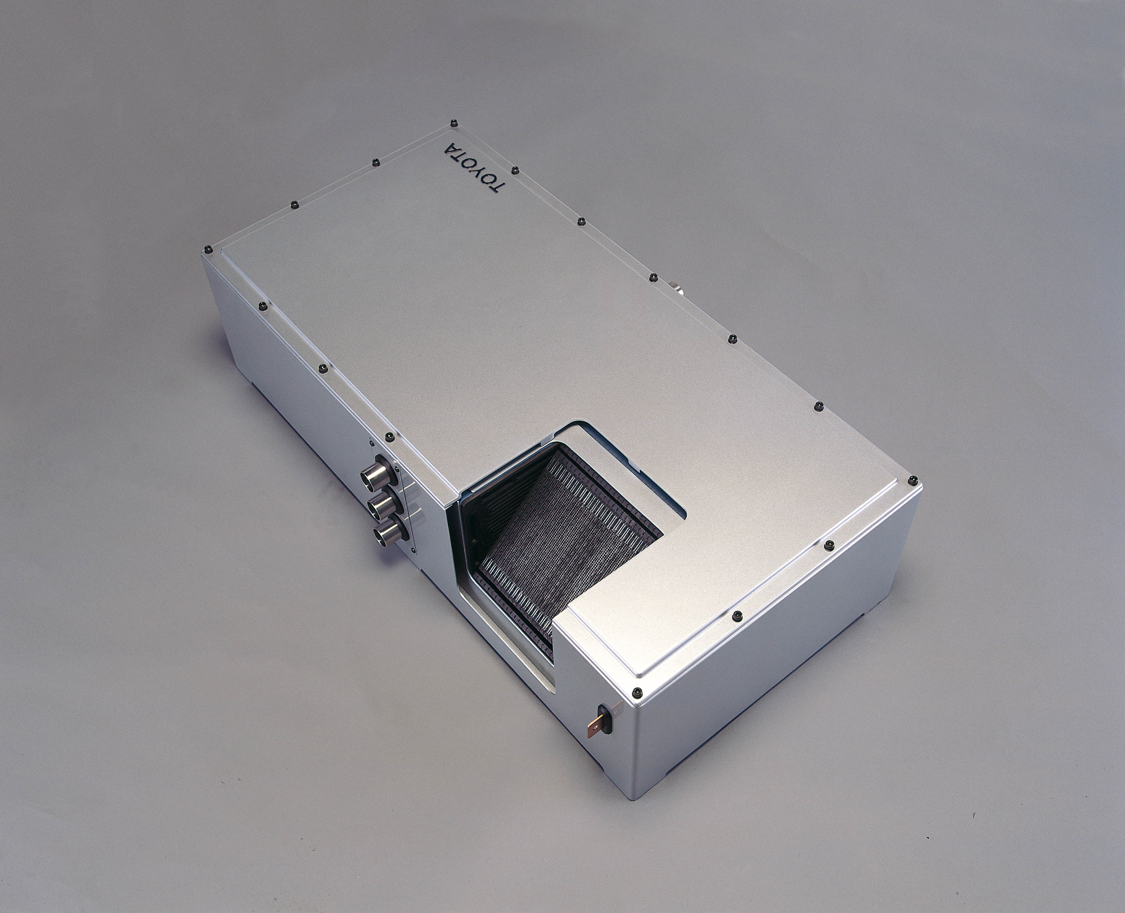
TOYOTA FCHV
Notes:
Now, I’d like to talk briefly about Toyota’s fuel cell vehicles.
* In 1996, Toyota demonstrated a hydrogen-absorbing alloy type FCHV.
* In 1997, we showed the world’s first methanol-fueled FCHV.
* We had recently been showing advanced component sets rather than vehicles.
* Then on March 1 of this year, we announced a new FCHV using an advanced hydride hydrogen storage system.

Slide 21
Fuel Cell System Characteristics
high-efficiency operating area
fuel cell system efficiency
Efficiency
ICE efficiency
0
Percent of peak power
Notes:
This graph shows the operating characteristics of a fuel cell system.
As you can see, like ICE power plants, it too has zones of relatively higher efficiency.
By employing a hybrid architecture, the FC system can be optimized to operate in these maximum efficiency areas. So, even when fuel cells replace internal combustion engines, to maximize system efficiency, appropriate energy management is still necessary. This means that a hybrid system, with a battery that is able to store and release extra energy, is required. Toyota sees this as another type of hybrid, and refers to it as the Fuel Cell Hybrid Vehicle (FCHV).

Slide 22
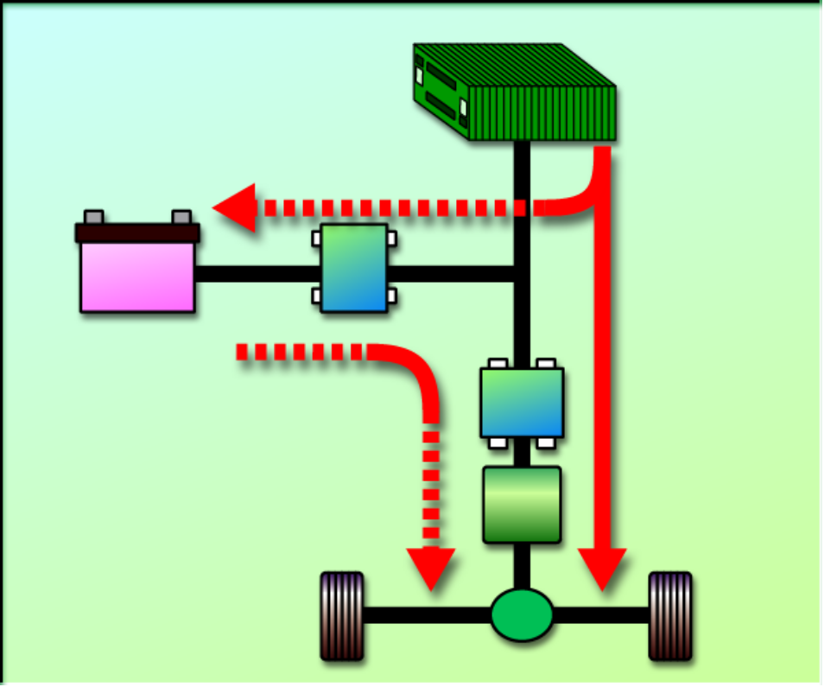
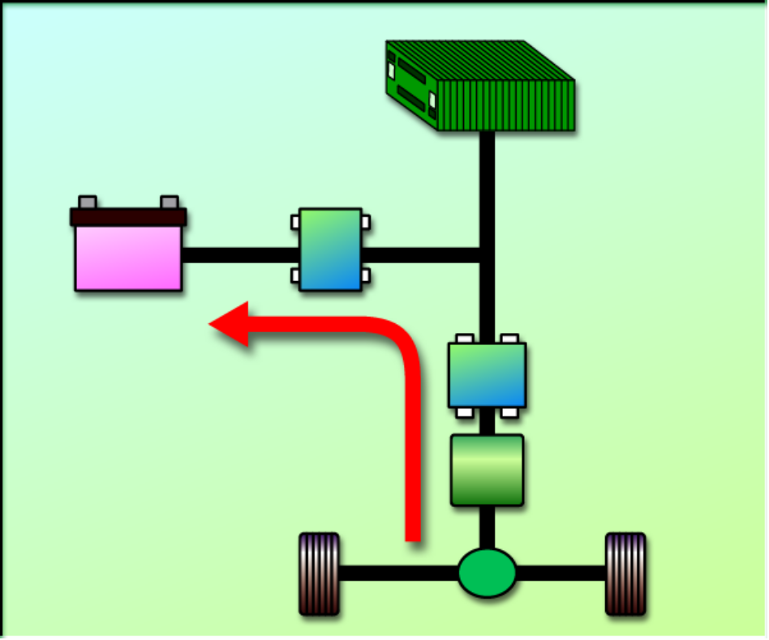
FCHV System
Normal Operation
Deceleration or Braking
fuel cell
fuel cell
battery
converter
converter
battery
inverter
inverter
motor
motor
Notes:
These diagrams show the combination of the FC and battery to create a flow of energy which provides maximum efficiency. Hybridization allows regenerative braking to convert kinetic energy into electric energy which is stored in the battery. It also allows storage of excess stack output for use as needed when this improves system efficiency. In many ways the basic idea is similar to the energy management system in Prius.

Slide 23
Current Issues for FCHVs
FC Stack
power, efficiency, size, cost, durability....
Reformer
start-up, response, efficiency, size, cost, durability....
H2 Absorbing Alloy Tank
H2 storage capacity, weight, cost, durability....
FCHV System
efficiency, size, cost, durability, start-up from low temp....
Fuel for FCHV
fuel choice, infrastructure....
Regulation, Standardization
Manufacturers/suppliers are addressing these areas
necessary for those in government and
in the FC world to cooperate with each other
Notes:
Unfortunately, since there are many technical issues which still need to be overcome, I believe it will be some years before we see the entry into the market place of FC vehicles.
Of course, many of these issues can be solved within the industry. However, there are other issues which require the team work of the auto industry, government and the energy industry. It will be necessary to work together towards decisions on fuel choice, infrastructure and standardization.

Slide 24
FCHV Fuel Choice in
Short to Mid-term
Safety
Continuous supply
Cost performance (CO₂ reduction)
Co-use of current infrastructure
Environmentally sensitive
Notes:
In the long term, I believe that hydrogen will be the fuel of choice for fuel cells, however, the infrastructure for a hydrogen supply is still a long way from being a realistic option.
In the meantime, I believe it will be hydrocarbon fuels that will provide the link.
It is important to pay close attention to these 5 points when considering what people are looking for in a fuel in the short to mid term time frame - safety, sustainability, good cost performance values in relation to a reduction in CO2 levels.
The fuel must be compatible with the existing infrastructure and it must possess the ability to respond to the same environmental issues driving conventional ICE vehicles.

Slide 25
Forecast of Automobiles in use
Around the World
Hydrogen cost + FC cost
ICE vehicles
ICE Fuel cost + ICE cost
ICE HVs
FCHVs
2000
20X0
year
Notes:
My personal opinion is that the use of hybrids will increase dramatically.
In particular, I believe that it will be possible to differentiate between ICE and FCHV hybrids, as this graph shows.
Of course, it will not happen for some time yet, but I believe the general popularity of FCHVs will begin later in this century, when the fuel and system costs of the FCHVs fall below the cost of ICE.

Slide 26
Forecast of Automobiles in use
Around the World
ICE vehicles
ICE HVs
FCHVs
2000
20X0
1. Era of co-existence of various power sources
2. Development of cleaner and more efficient vehicles, engines, and fuel technologies, in addition to infrastructure are all important
Notes:
There are two further points I would like to add.
The first is that I absolutely believe we will not soon see the end of the ICE era. There will not be an abrupt transition to the FC era, with hybrids serving as the exclusive interim measure.
Rather, I believe that there will be a long time when various engines and power sources will exist simultaneously.
I am also very concerned that in addition to realizing the importance of continued development of hybrids and FCs, we all remember the huge number of ICE vehicles that already exist.
We all need to put continued efforts into cleaning up these engines and making them more efficient.

Slide 27

Notes:
We have already delivered more than 60,000 Prius vehicles globally. Although this number is small compared to Camry, it exceeds the total sales of all other “eco” vehicles.
Automobile manufacturers alone will not decide which technologies eventually win out toward the ultimate eco-car in the marketplace. That decision will be made by society. We believe that hybrid vehicles represent a practical way of lowering the environmental impact of the automobile while still offering the customer the attributes he or she has come to expect. We believe they are the logical transition to the future. I’d be glad to answer your questions at this time.

